Slide 1

Think about Thinking
Eng. Karim Nashaat
Bibliotheca Alexandrina
Center for Special Studies and Programs
Karim.nashaat@bibalex.org
Notes:
descion makers one day and you will sit in meetings trying to decide on something , so that is why ia m giving you a hint about a thinknig frame work

Slide 2


Slide 3


Slide 4
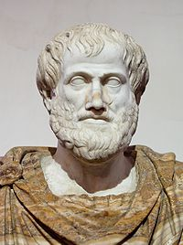
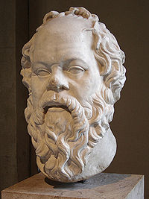
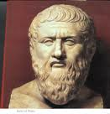
Thinking 300 BC
ANALYSIS of the past and Reasoning
Why things are
wrong
Socrates
Plato
Aristotle
TRUTH

Slide 5
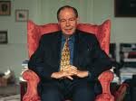
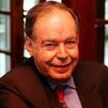


Slide 6


White Hat
What ….. is available?
What …….. is needed ?
What …… is missing ?
How to get ….. ??
A
B

Slide 7





Red Hat
Feelings
Emotions

Slide 8
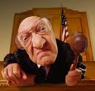



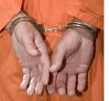

Black Hat
Caution
Risk
Difficulties

Slide 9




Yellow Hat
Logical Positive
Benefits
Value sensitive

Slide 10
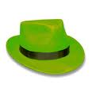

Green Hat
Creative
Different
New alternatives
possibilities

Slide 11



Blue Hat
Decision
Outcomes
Coming Agenda

Slide 12
Conclusion
SUBJECT

Slide 13

Eng. Karim Nashaat
Bibliotheca Alexandrina
Center for Special Studies and Programs
Karim.nashaat@bibalex.org

